Slide 1
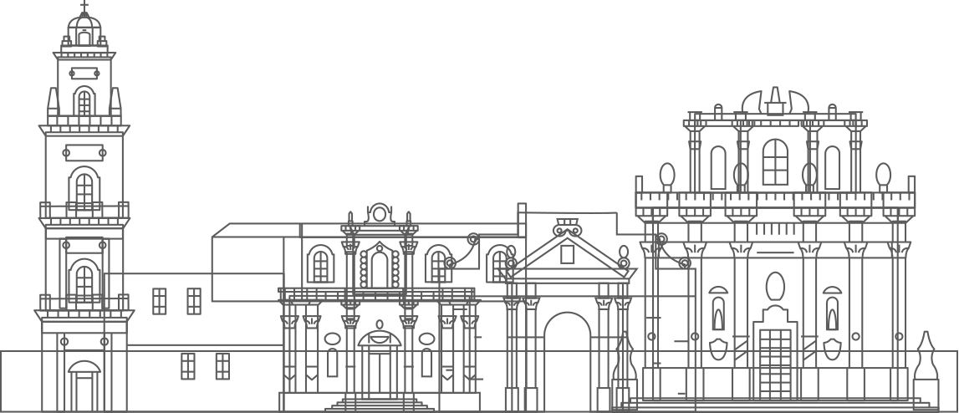
Dr. Octavian Pacioglu, National Institute of Research and Development for Biological Sciences, Bucharest, Romania

Slide 2
Freshwater biologist with ten years experience in various projects on aquatic ecology
Romanian Waters Company, Romania, biologist (2004)
Institute of Speleology «Emil Racovita», research assistant, Romania (2005)
National Institute of Research and Development for Grasslands, research assistant, Romania (2006)
PhD student, Roehampton University, London, UK (2007-2012)
1Postdoc: Institute for Freshwater Ecology and Inland Fisheries, Berlin, Germany (2012)
2Postdoc: Queen Mary University of London, River Laboratory-Dorset, UK (2013-2015)
3Postdoc: West University of Timisoara, Romania (2016-2017)
Research assistant –Wesy University of Timisoara, Romania (2017-2018)
Since February 2019-Scientist at National Institute of Research and Development for Biological Sciences, Bucharest, Romania
Name
Affiliation

Slide 3
Data management-related experiences
Beginner in data management

Slide 4
Expectation from the summer school
To learn the basics of FAIR data management, liase with other participants in related fields and with similar research interests.

Slide 5
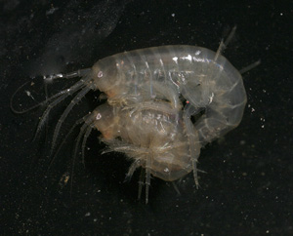
Case study: the adaptation of the amphipod Gammarus balcanicus in a sinking-cave stream from Western Carpathians (Romania). Example: preparing data and metadata regarding the body length of two populations dwelling both outside and within the cave. Samples were taken bimonthly between Septermber 2017-July 2018. For the case study presented today, I have preparaed a database comprising information related to species location, separation according to their habitat (outside the cave and within the cave), sexual maturity (mature and juvenile) and gender (male or female) presented.

Slide 6


Slide 7


Slide 8


Slide 10
Body-size distribution bimodal for both populations, suggestion a life-cycle longer then a year for both populations.
Both subterranean males and females significantly larger compared to surface counterparts.
50% of individuals probability shows that reach sexual maturity is longer for both subterranean genders compare to surface ( meaning that the cave individuals have a delayed sexual maturity).

