Slide 1
Lightweight Service Management for Research Infrastructures: The FitSM Approach
Sy Holsinger, EGI Foundation
Senior Strategy and Policy Officer
Giuseppe La Rocca, EGI Foundation
Technical Outreach Expert

Slide 2
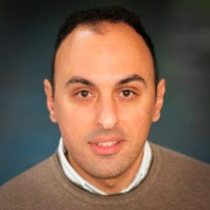
Today’s presenter
Background
  MSc in Computer Science Engineering from the University of Catania (Italy)
  14 years experience in EC-funded projects
At EGI Foundation
  Technical Outreach Expert
  Chief Community Officer of the EGI.eu User Community Board (UCB) group
  Holds a FitSM Advanced SOC and SPD, and
  ISO/IEC 27K Foundation certifications
https://www.egi.eu/about/egi-foundation/team/giuseppe-la-rocca/
https://www.linkedin.com/in/giuseppe-la-rocca-81838784

Slide 3

Today’s presenter
Background
  Studied Business Mgmt. & Communications (U.S.)
  10+ years experience in EC projects
At EGI Foundation
  Business and sustainability model development
  Strategy planning; market/trend analysis
  Project and virtual team management
  In-house ITSM consultant
  Expert, trainer, auditor (ISO 19011) in:
    FitSM standard (service management)
    ISO/IEC 27001 (information security)
  Member of ITEMO (IT Education Management Organization) FitSM working group
https://www.egi.eu/about/egi-foundation/team/sy-holsinger/
https://www.linkedin.com/in/syholsinger/

Slide 4
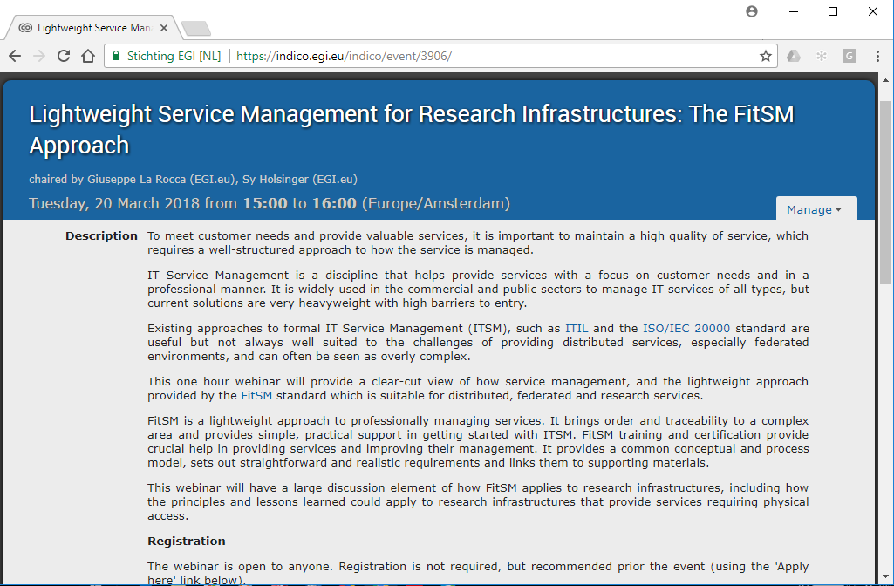
Agenda

Slide 5

This webinar is being recorded

Slide 6
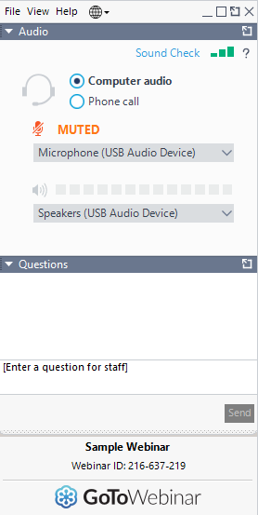
Audience Q&A session
Please write your questions in the questions window of the GoToWebinar application

Slide 7
Lightweight Service Management for Research Infrastructures: The FitSM Approach
Sy Holsinger, EGI Foundation
Senior Strategy and Policy Officer
Giuseppe La Rocca, EGI Foundation
Technical Outreach Expert

Slide 8
Content Outline
Intro to IT Service Management
  Incl. rationale for research
History and overview of FitSM
  Incl. examples of adoption in research/academia
Training opportunities
Open Discussion/Q&A

Slide 9
Intro to ITSM

Slide 10
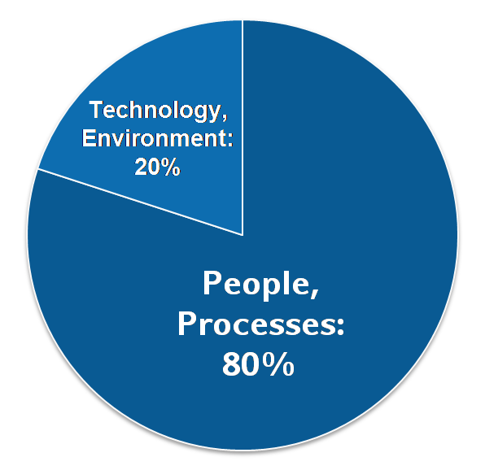
IT Service Management
Why IT service management (ITSM)?
  About 80% of all IT service outages originate from "people and process issues"
  Duration of outages and degradations significantly dependent on non-technical factors
IT service management
  Focuses on the provision of high quality IT services that meet customers' and users’ expectations
  Defines, establishes and maintains service management processes through assigned roles and responsibilities
Reasons for service outages
[Gartner]

Slide 11

IT Service Management……in Research
Shift in expected results
  FP7 -> H2020 = Publications -> Services
  Focus on Sustainability!
Increased customer expectations
  Commoditization of digital services
  XaaS (Anything as a Service) now commonplace
Lack of skills
  Limited to no formal training in how to professionally plan, deliver, operate and control IT services
We are now service providers?

Slide 12
ITSM Success Factors
People
Processes
Technology
Skills
Awareness
Defined activities
Responsibilities
Support people in their roles
Effectiveness and repeatability
Increase process effectiveness and efficiency
Typical tools for service management:
Workflow support tool
(Trouble) ticket tool
Wiki
Excel sheets
Word templates
…
Typical service management processes:
Service portfolio management
Service level management
Incident management
Change management
Capacity management
Information security management
…

Slide 13
What is a process?
Definition following FitSM-0:
Process: Set of activities that bring about a specific objective or set of results from a set of defined inputs.
3 basic facts about IT service management processes:
  ITSM processes support the delivery of IT services
  To provide one IT service to a customer, often several processes are needed
  An IT service being successfully delivered is the result from many processes successfully operating and interacting

Slide 14
What comprises a process?
Set of interrelated activities
Roles and responsibilities
Goal(s), objectives
Clearly defined inputs and outputs

Slide 15
Roles and Responsibilities (People)
SMS owner (x1)
SMS manager (x1)
Process owner (optional; x1 per process)
Process manager (x1 per process)
Case owner (x1 per case – e.g. SLA, incident)
Member of process staff
Service owner (x1 per service)
(Internal) ITSM consultant
(Internal) ITSM auditor
Process owner
1
1..*
Process manager
1
1..*
Process
staff member

Slide 16

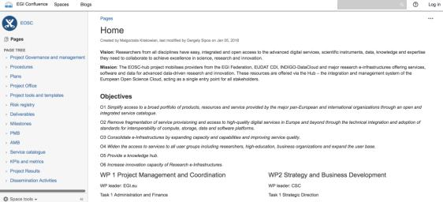
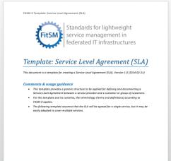
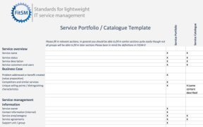
Tools (Technology)
Ticket tool
  e.g. GGUS, JIRA, RT
Wiki
  e.g. Confluence, Wikimedia
Templates
  e.g. Word docs, Excel, Google Apps, Forms

Slide 17
History and Adoption of FitSM

Slide 18
History of the FitSM standard
2012
2013
2015
2017
FedSM Project starts (FP7)
- Initial Goal: Help e-Infrastructures increase professional service delivery (Client partners: EGI, CSC, PLGrid)
Creation of FitSM
- Realization of market gap for lightweight approach
- Formalised standard and training certification scheme
Commercialization (FedSM ends - Sept)
- Established ITEMO (non-profit to host FitSM license and maintain standard)
- Contract Negotiation with Certification Authority (TUV SUD)
- Accreditation of training organisations
Sustainability
- ~1000 certificates awarded
- 15+ Accredited Training Organisations
- New certification authority (ICO-Cert)

Slide 19




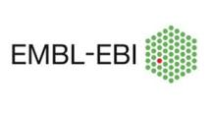







FitSM adoption: Research/Academia
Organizations
Federations
*Non-exhaustive list

Slide 20
FitSM Overview

Slide 21



What is FitSM?
Standards family for lightweight IT service management
Suitable for IT service providers of any type and scale
Main design principle: Keep it simple!
All FitSM parts are freely released under Creative Commons licenses
FitSM is operated and managed by ITEMO (non-profit)
Certification is provided through ICO-Cert
www.fitsm.eu
The development of FitSM was originally funded by the European Commission through an EC-FP7 project "FedSM“

Slide 22

Accessible

Slide 23


FitSM Standard Family and Licenses
Core Standard
FitSM-0
Overview & vocabulary
Normative
FitSM-1
Requirements
FitSM-2
Objectives and activities
FitSM-3
Role model
Informational
Implementation aids
FitSM-4
Selected templates and samples
FitSM-5
Selected implementation guides
FitSM-6
Maturity and capability assessment scheme

Slide 24
FitSM Process Model
Service Portfolio Management
Most strategic
Service Level Management
Service Reporting
Service Availability and Continuity Management
More strategic
Capacity Management
Core management processes for any IT service
Information Security Management
Customer Relationship Mgmt
Supplier Relationship Management
Incident and Service Request Mgmt
Problem Management
Configuration Management
More operational
Change Management
Release and Deployment Mgmt
Continual Service Improvement

Slide 25
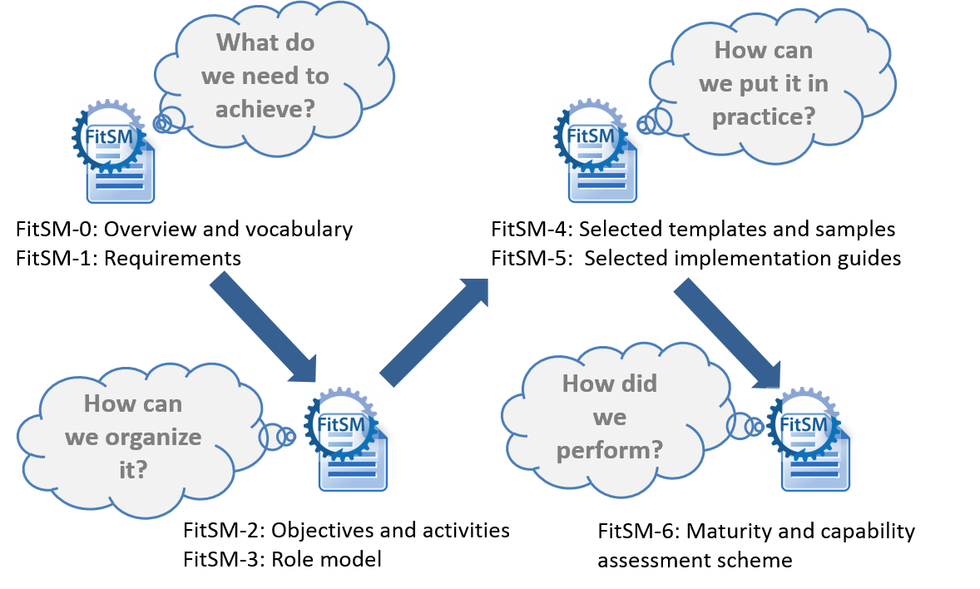
FitSM Logic

Slide 26
FitSM-1: Requirements
FitSM-1 defines 85 requirements that should be fulfilled by an organisation (or federation) offering IT services to customers
Compliance with the 85 requirements can be regarded as a "proof of effectiveness"
The 85 requirements are structured as follows:
  16 general requirements (GR)
  69 process-specific requirements (PR)
    Consideration of the 14 IT service management processes from the FitSM process model
    Between 2 and 8 requirements per process

Slide 27
Common language and organizational support

Slide 28
FitSM-0: Overview and Vocabulary
FitSM-0 defines 70 important terms from the IT service management context
In alphabetical order:
  Accessibility of information
  Activity
  Assessment
  Audit
  Availability
  Capability
  Capacity
  Change
  Classification
  Closure
  Competence
  Compliance
  Confidentiality of information
  Configuration baseline
  Configuration item (CI)
  Configuration management database (CMDB)
  Continuity
  Customer
  Document
  Effectiveness
  Efficiency
  Escalation
  Federation member
  Federator
  Incident
  Information security
  Information security control
  Information security event
  Information security incident
  Integrity of information
  IT service
  IT service management (ITSM)
  Key performance indicator (KPI)
  Known error
  Management system
  Maturity
  Nonconformity
  Operational level agreement (OLA)
  Operational target
  Policy
  Post implementation review
  Priority
  Problem
  Procedure
  Process
  Record
  Release
  Request for change
  Risk
  Role
  Service
  Service acceptance criteria (SAC)
  Service catalogue
  Service component
  Service design and transition package
  Service level agreement (SLA)
  Service management
  Service management plan
  Service management system (SMS)
  Service portfolio
  Service provider
  Service report
  Service request
  Service target
  Supplier
  Top management
  Underpinning agreement (UA)
  Underpinning contract (UC)
  User
  Value

Slide 29

Key concepts: Service vs. Service Component
A service usually provides value when taken on its own – unlike the specific service components they are composed of composed of different service components, which may:
  Enable the service (enabling service components)
    What the customer has asked to be provided
  Enhance the service (enhancing service components)
    Added to make the service more attractive to the customer
Service
Customer

Slide 30
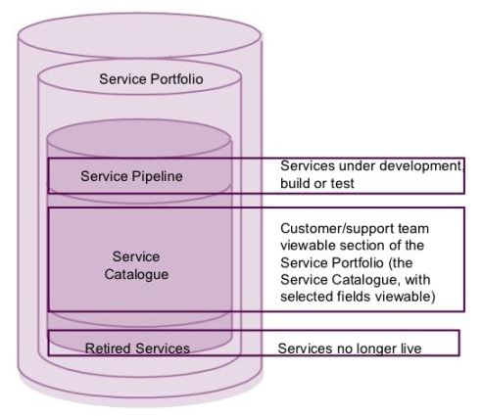
Key concepts: Service Portfolio vs. Service Catalogue
The service portfolio is the basis for the service catalogue
Customer

Slide 31
Key concepts: SLA vs. OLA
Customer
Service level agreements (SLAs)
Service A
Service B
Service C
(IT) service
provider
Service components
Operational level agreements (OLAs)
Underpinning agreements (UAs)
Internal groups or federation members
Suppliers

Slide 32
Compatible with existing standards/frameworks

Slide 33



Third way for ITSM
‘Full’ commercial ITSM
FitSM Solution
More achievable
More suitable
Path to ‘full’ ITSM
Freely available
No/little formal ITSM
ISO/IEC 20000

Slide 34
Related standard and frameworks
ISO 9000
ISO/IEC 27000
ISO/IEC 20000
Legend
ITIL
FitSM
IT service management
standard / framework
Quality management
standard
COBIT
Information security
management standard
Software engineering
maturity model
ISO 15504
CMMI
adoption of concepts

Slide 35




ITIL, ISO/IEC 20000, COBIT
IT Infrastructure Library (ITIL) Number of books with "good practice" in IT Service Management Slogan: "the key to managing IT services" Descriptions of key principles, concepts and processes in ITSM | Popular and wide-spread framework Not a "real" standard, but often regarded to as "de-facto standard" 5 books released by the British Cabinet Office
ISO/IEC 20000 International standard for managing and delivering IT services Requirements for a service management system (SMS) | Developed by a joint committee (JTC) of ISO and IEC Based on ITIL, BS 15000 Auditable, certifiable
Control Objectives for Information and Related Technologies (COBIT) Framework for governance and management of enterprise IT | Developed by ISACA can be combined with ITIL and ISO/IEC 20000
ISO/IEC 20000

Slide 36

ISO 9000, ISO/IEC 27000, CMMI
ISO 9000 International standard for quality management Quality management principles Requirements for a quality management system | Applicable to all organizations and branches Auditable, certifiable Several documents
ISO/IEC 27000 International standard for information security management Requirements for an information security management system (ISMS) More than 100 security controls | Applicable to all organizations and branches Auditable, certifiable Based on BS 7799 Auditable, certifiable Several documents
Capability Maturity Model Integration Maturity and capability model Organizational maturity assessment | Developed by SEI (Software Engineering Institute), Carnegie Mellon University
ISO 9000
ISO/IEC 27000

Slide 37
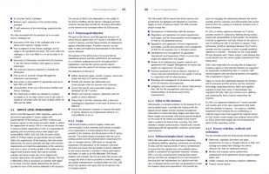
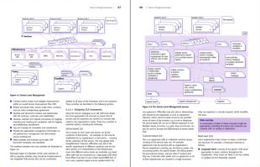
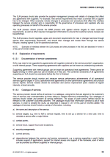
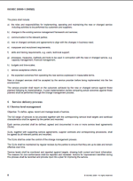
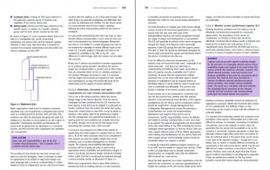

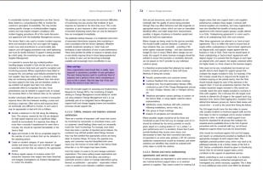
Lightweight compared!
ISO/IEC 20000
136 pages (3 core documents)
26 pages of requirements (part 1)
FitSM
38 pages (4 core documents)
9 pages of requirements (part 1)
ITIL (good practices)
About 2,000 pages (5 core books)
No requirements

Slide 38
FitSM and ISO/IEC 2000 Processes
Service Portfolio Management
(Design and transition of new or changed services)
Service Level Management
FitSM
Service Reporting
ISO/IEC 20000
Service Availability and Continuity Management
Capacity Management
Information Security Management
Budget & Accounting
Customer Relationship Mgmt
Business Relationship Mgmt
Supplier Relationship Management
Incident and Service Request Mgmt
Problem Management
Configuration Management
Change Management
Release and Deployment Management
Continual Service Improvement
(Maintain and improve the SMS)

Slide 39

Training and Certification Scheme

Slide 40
FitSM Training and Certification Programme
Expert Level
Expert Level
2 days
2 days
ITIL Expert, ISO/IEC 20000 consultant and auditor
Expert training in IT service management
Expert Bridge
Advanced Level
2 days
2 days
Advanced training in
service planning and delivery
Advanced training in
service operation and control
Foundation Level
Foundation training in IT service management
1 day

Slide 41
FitSM Foundation Training Topics
IT Service Management
  Introduction, Terms & Concepts
The FitSM Standards Family
  Background and overview of FitSM standard
  General aspects and requirements
  Process model and requirements
Benefits, Risks & Challenges of Implementing IT Service Management
Related Standards & Frameworks
Exam
  20 multiple choice questions; 65% to pass

Slide 42
FitSM Advanced SPD Training Topics
Repeat the most important Foundation knowledge
Dive deeper into
  General aspects of “implementing” ITSM
    Top management; Documentation; Scope; Continual Improvement
  8 processes related to service planning and delivery
    Service Portfolio; Service Level; Service Reporting; Service Availability and Continuity; Capacity; Information Security, Customer and Supplier Relationship Management
    Process set-up and running; roles and responsibilities; interfaces; critical success factors and KPIs
Exam
  30 multiple choice questions; 70% to pass

Slide 43
FitSM Advanced SOC Training Topics
Repeat the most important Foundation knowledge
Dive deeper into
  General aspects of “implementing” ITSM
    Top management; Documentation; Scope; Continual Improvement
  6 processes related to service operation and control
    Incident and Service Request; Problem; Configuration; Change; Release and Deployment Mgmt.; Continual Service Improvement
    Process set-up and running; roles and responsibilities; interfaces; critical success factors and KPIs
Exam
  30 multiple choice questions; 70% to pass

Slide 44
FitSM Expert Training Topics
ITSM-related frameworks and standards
  ITIL, COBIT, ISO 9000, ISO2000, ISO 27000
Understanding the organizational context of delivering and managing services
Leadership and governance
  Effective polices and communication; Governance; Managing Risk
Planning and implementing ITSM
  Plans; Roles; Training and awareness; Organizational Change
Monitoring, reviewing and improving ITSM
  Conformity, effectiveness, and efficiency; KPIs; Auditing; Capability and maturity assessments; Management reviews
Exam
  30 questions (6 T/F each); 75% to pass (135 pts out of 180)

Slide 45
EGI FitSM Training Offers

Slide 46
EGI FitSM Training Types
In-House Training
  Held within requesting institution premises at a mutually agreed time/place
  Cost effective when needing several individuals to be trained
  More info: https://www.egi.eu/services/fitsm-training/in-house-training/
Open Registration Training
  Individuals to attend a pre-determined location and date (e.g. Amsterdam)
  More info: https://www.egi.eu/services/fitsm-training/calendar/
EOSC-hub Project
  Offering free courses for project members, initial focus on Foundation
  More info (coming): http://www.eosc-hub.eu/

Slide 47
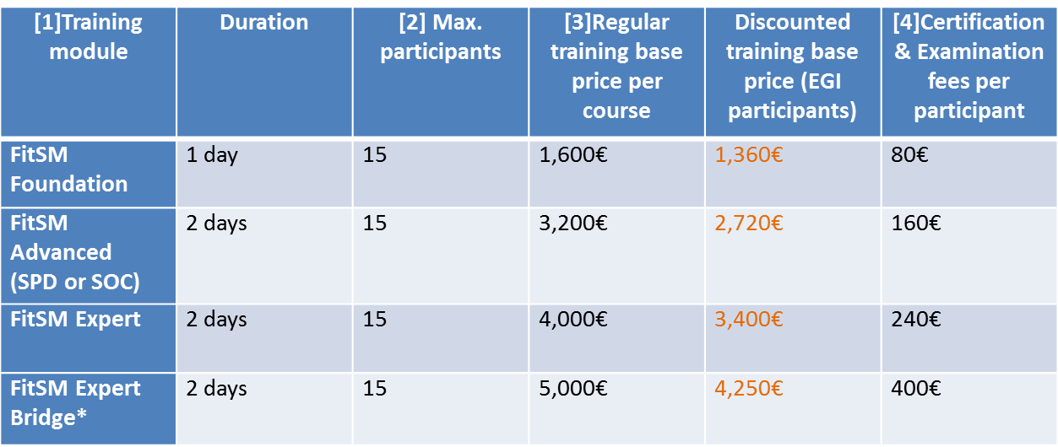
EGI FitSM In-House Training Prices

Slide 48
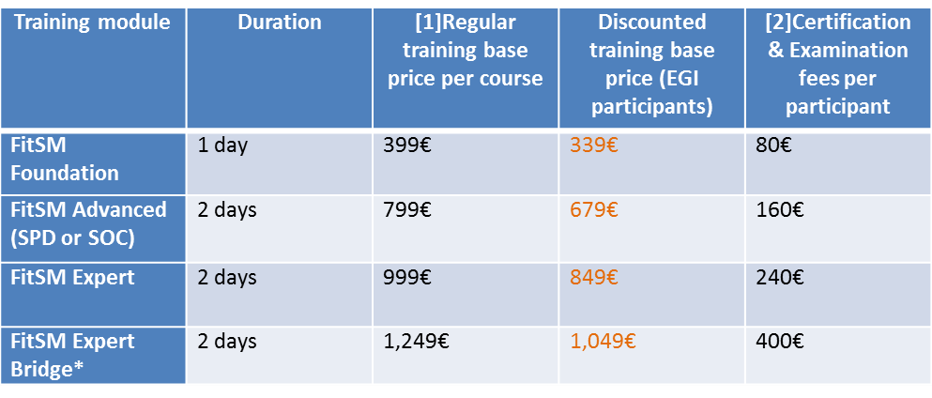
EGI FitSM Open Training Prices

Slide 49
Upcoming Trainings
FitSM Training and Certification
  EOSC-hub Week – Malaga (free to conference attendees)
    http://eosc-hub.eu/events/eosc-hub-week-16-20-april-2018-malaga-spain
    Foundation: 19-20 April 2018
    Others to be run throughout the project
  Open Registration – Amsterdam (registration fee)
    Foundation: 22-23 May 2018 (reduced price, supported by EOSCpilot project)
    Advanced Service Planning and Delivery (SPD): 23-25 May 2018
    Advanced Service Operation and Control (SOC): 4-6 June 2018
    Expert: 6-8 June 2018
  In-house courses available upon request
    https://www.egi.eu/services/fitsm-training/in-house-training/
ISO 27001 – Information Security Management
  Foundation: 17-19 Sept 2018 – Amsterdam
  Professional: Planned, dates not yet finalized - Amsterdam

Slide 50
sy.holsinger@egi.eu
giuseppe.larocca@egi.eu
Thanks!
Discussion/Q&A
@syholsinger
@FitSM_Standard
@EOSC_eu
20 March 2018

Slide 51

EOSC-hub Week - 16-20 April 2018
Malaga, Spain

